Slide 1
Hierarchical Modeling I
  <number>/43
模型是对世界的抽象，图形学中用“几何对象”构建模型。
需选择建立模型需使用的图元及图元之间的关系
好的模型能够充分利用图形系统的性能。

Slide 2
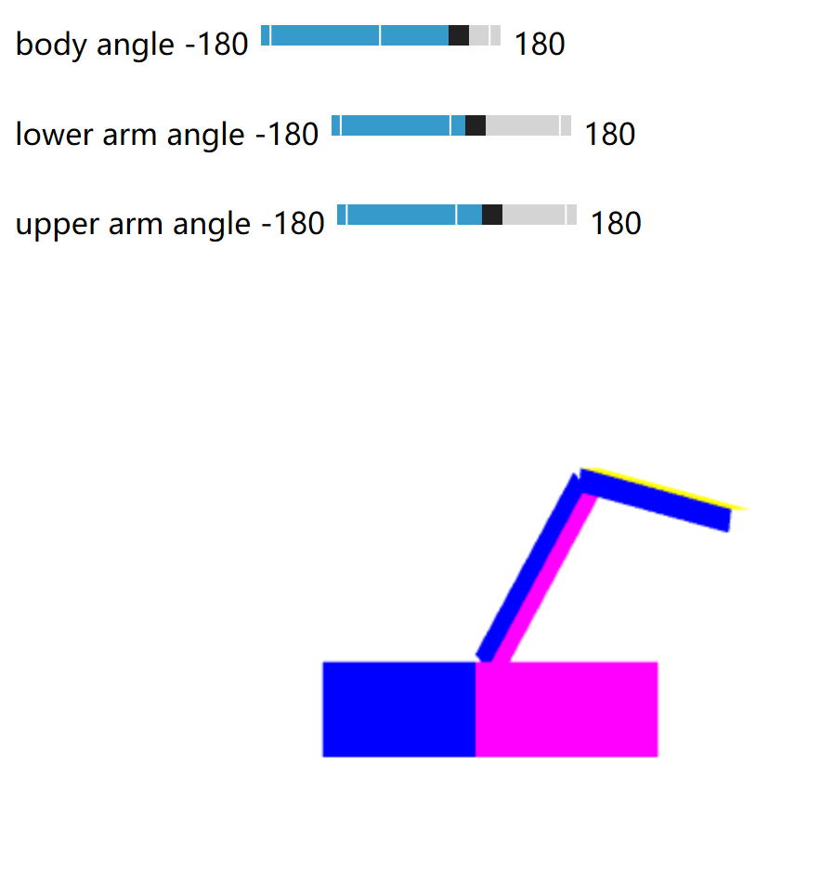
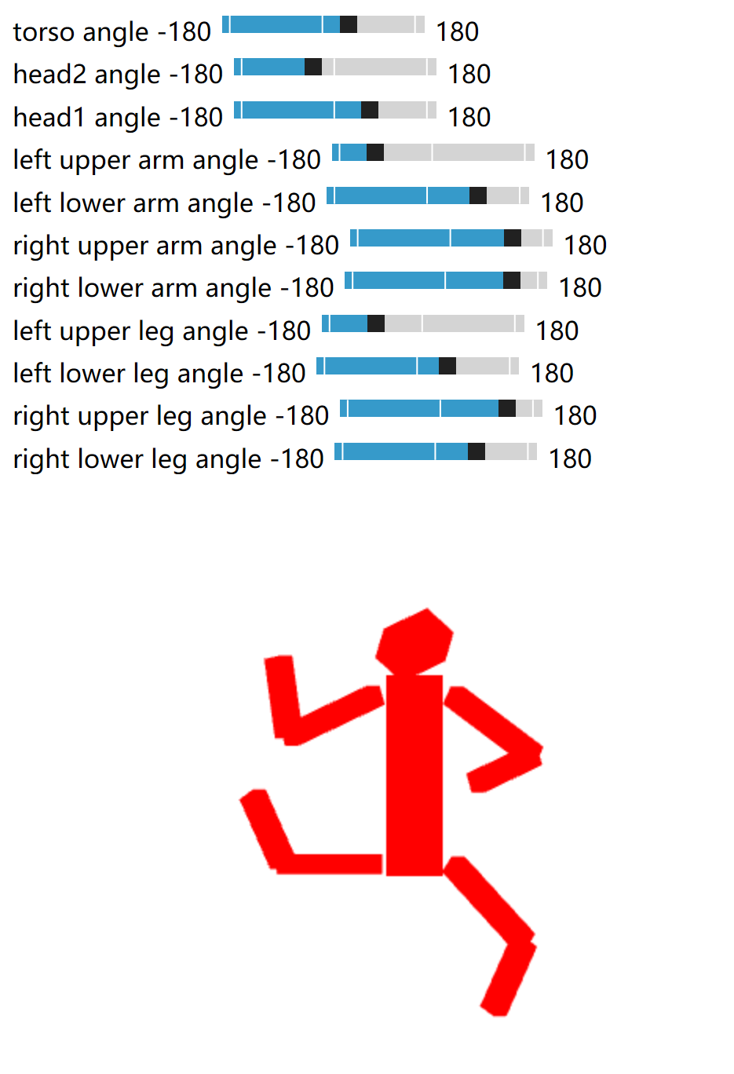
层次模型
  <number>/43
Chap9 example:

Slide 3
  <number>/43
Outline
Examine the limitations of linear modeling
  Symbols and instances（图符和实例）
Introduce hierarchical models层级模型
  Articulated models（铰接模型）
    Example RobotArm: Simple Tree
    Example Figure: Left-Child Right-Sibling Tree
Notes:
模型是对世界的抽象。
计算机科学领域，使用“抽象数据类型”表示对象之间的结构关系；图形学中用“几何对象”构建世界的模型。
需要选择模型使用的图元及图元之间的关系。因为好的模型能够充分利用图形系统的性能。

Slide 4
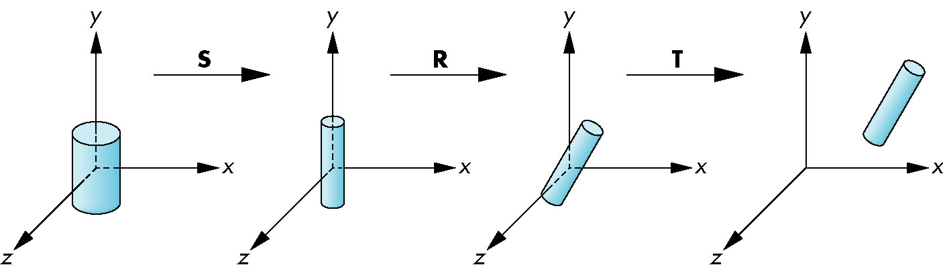
Instance Transformation
  <number>/43
a prototype object ~a symbol~图符
Each appearance of the object in the model is~ an instance~实例
  Must scale, orient, position
  Defines instance transformation : TRS 实例变换
Notes:
图符

Slide 5
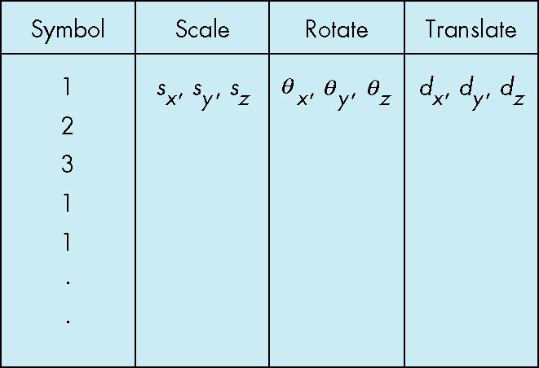
Symbol-Instance Table
  <number>/43
store a model by
assigning a number to each symbol and
storing the parameters for the instance transformation M=TRS
Symbol-Instance Table

Slide 6
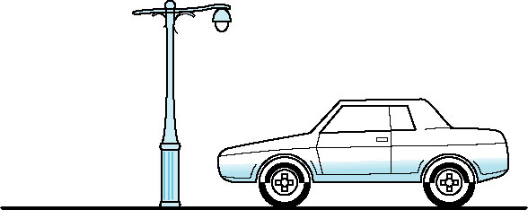
Example
  <number>/43
Sysbol | Scale | Rotate | Translate
1-Pbody | sx1,sy1,sz1 | αx1,αy1, αz1 | dx1,dy1,dz1
2-Pwheel | sx2,sy2,sz2 | αx2,αy2, αz2 | dx2,dy2,dz2
2-Pwheel | sx3,sy3,sz3 | αx3,αy3, αz3 | dx3,dy3,dz3
2-Pwheel | sx4,sy4,sz4 | αx4,αy4, αz4 | dx4,dy4,dz4
2-Pwheel | sx5,sy5,sz5 | αx5,αy5, αz5 | dx5,dy5,dz5
  Carbody=T1 *R1 *S1 * Pbody
  FrontLeftwheel=T2*R2* S2* Pwheel
  FrontRightwheel=T4*R4* S4* Pwheel
  BackLeftwheel=T3*R3* S3* Pwheel
  BackRightwheel=T5*R5* S5* Pwheel
Notes:
1.公转的轨道是椭圆，用圆模拟
2.R(自转)这里需要： 先地球轴心偏转,然后绕轴心自传，然后转回来， 所以应该是：Rz(phi)*Ry(自转角)*Rz(-phi),,,, Phi= 23.26, 绕Z轴旋转
地球自转：地球绕自转轴自西向东的转动，从北极点上空看呈逆时针旋转，从南极点上空看呈顺时针旋转。地球自转轴与黄道面成66.34度夹角，与赤道面垂直。关于地球自转的各种理论目前都还是假说。地球自转是地球的一种重要运动形式，自转的平均角速度为 4.167×10⁻³度/秒，在地球赤道上的自转线速度为465米/秒。地球自转一周耗时23小时56分，约每隔10年自转周期会增加或者减少千分之三至千分之四秒。
公转夹角~https://baike.baidu.com/item/地球绕太阳公转/2257596?fr=aladdin
地球的自转轴与其公转的轨道面成66°34′的倾斜。这个角度同人们拿铅笔书写时笔杆与桌面的倾斜相仿。人们有时形象地比喻为地球“斜着身体”绕太阳公转。
地球的自转同它公转之间的这种关系，天文学和地理学上通常用它的余角（23°26′），即赤道面与轨道面的交角来表示；而在地心天球上，则表现为黄道与天赤道的交角，并被称为黄赤交角，又称"黄赤大距"。
课看作第四章的 instance transformation , 如trackball程序中，连续的旋转变换。

Slide 7
图符和实例建模的优缺点
  <number>/43
优点：
  数据结构简单：表格或一组几何对象的模型
  可以从表格搜索某个对象，或者改变某个对象的实例变换，也可以添加或删除对象。
缺点：
  单一的线性表示，限制了其应用（对于图符之间结构不能表达，如层次结构，网状结构）

Slide 8
  <number>/43
Outline
Examine the limitations of linear modeling
  Symbols and instances（图符和实例）
Introduce hierarchical models层级模型
  Articulated models（铰接模型）
    Example RobotArm: Simple tree
    Example Figure: Left-Child Right-Sibling Tree
Notes:
模型是对世界的抽象。
计算机科学领域，使用“抽象数据类型”表示对象之间的结构关系；图形学中用“几何对象”构建世界的模型。
需要选择模型使用的图元及图元之间的关系。因为好的模型能够充分利用图形系统的性能。

Slide 9
Relationships in Car Model
  <number>/43
Consider model of car
  Chassis + 4 identical wheels （Two symbols）
car()
{
chassis()；
wheel(right_front);
wheel(left_front);
wheel(right_rear);
wheel(left_rear);
}
Symbol-instance table does not show relationships between parts of model 符号实例模型没有表示各部分的关系
Fails to show relationships well, Structure Through Function Calls
Rate of forward motion determined by rotational speed of wheels
Look at problem using a graph（tree）
Notes:
Chassis:ʃæsɪ; -iː] 美 [‘ʃæsi] 跟读 口语练习 n. 底盘，底架
书上的例子更好些

Slide 10
Graphs
  <number>/43
Graph：Set of nodes and edges (links)
Edge： connects a pair of nodes(Directed or undirected)
Cycle: directed path that is a loop
loop
Notes:
有向和无向的
有向路径构成一个循环，称为环

Slide 11
Tree
  <number>/43
Tree: Graph in which
  each node has exactly one parent node(except the root)
  each node may have multiple children(Leaf or terminal node: no children)
root node
leaf node

Slide 12
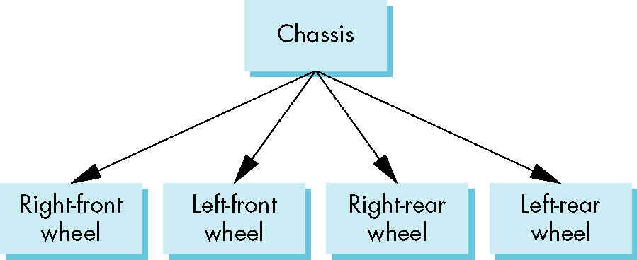
Tree Model of Car
  <number>/43
汽车的树结构
Notes:
例子

Slide 13
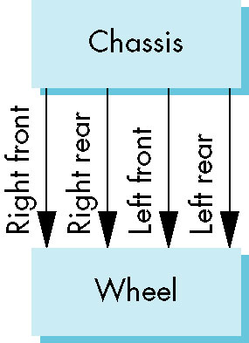
DAG Model of Car
  <number>/43
汽车的有向无环图DAG
all the wheels are identical(相同), we get a directed acyclic graph（有向非循环图），
  Not much different than dealing with a tree
Notes:
If we use the fact that all the wheels are identical(相同), we get a directed acyclic graph
使用单个图符实例

Slide 14
  <number>/43
Outline
Examine the limitations of linear modeling
  Symbols and instances（图符和实例）
Introduce hierarchical models层级模型
  Articulated models（铰接模型）
    Example RobotArm: Simple tree
    Example Figure: Left-Child Right-Sibling Tree
Notes:
模型是对世界的抽象。
计算机科学领域，使用“抽象数据类型”表示对象之间的结构关系；图形学中用“几何对象”构建世界的模型。
需要选择模型使用的图元及图元之间的关系。因为好的模型能够充分利用图形系统的性能。

Slide 15
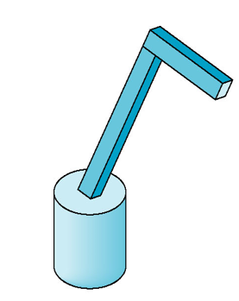
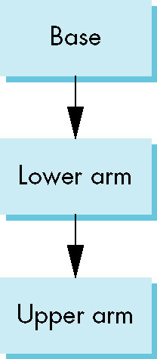
Modeling with Trees
  <number>/43
Must decide what information to place in nodes and what to put in edges
Nodes：
  What to draw，Pointers to children
Edges
  May have information on incremental changes to transformation matrices (can also store in nodes)
robotArm
绘制这种树结构表示的对象需要执行树的遍历：
访问每个节点时，必须计算相应的变换矩阵，
该矩阵作用于该节点图元后显示图元
shows relationships between parts of model，Can change “look” of parts easily without altering relationships
Notes:
Want a general node structure for nodes
WEBGL程序采用了增量方法来实现这种遍历操作

Slide 16
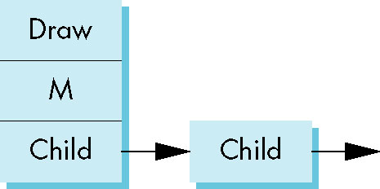
Possible Node Structure
  <number>/43
如果把所有信息都存储在节点中而不是边上，则每个节点至少包含下面3项目信息
Code for drawing part or
pointer to drawing function
matrix relating node to parent
linked list of pointers to children
Notes:
robertArm没有把矩阵放在节点，而是放在边上（程序里）
函数指针，指向一个用于绘制 该节点所表示的对象的函数
齐次坐标矩阵，表示该节点相对于它的双亲节点的位置的变换矩阵
指向孩子节点的指针

Slide 17
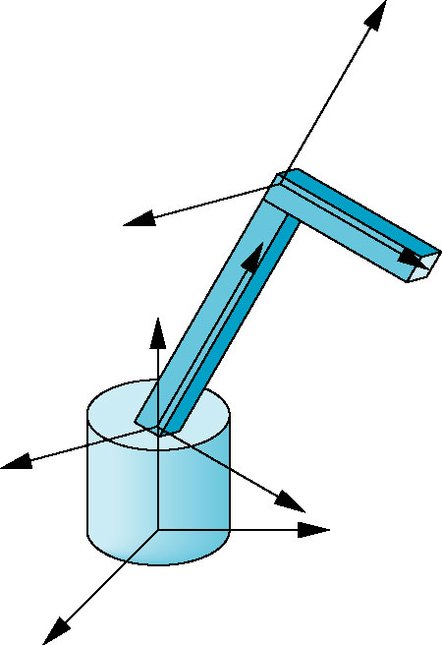
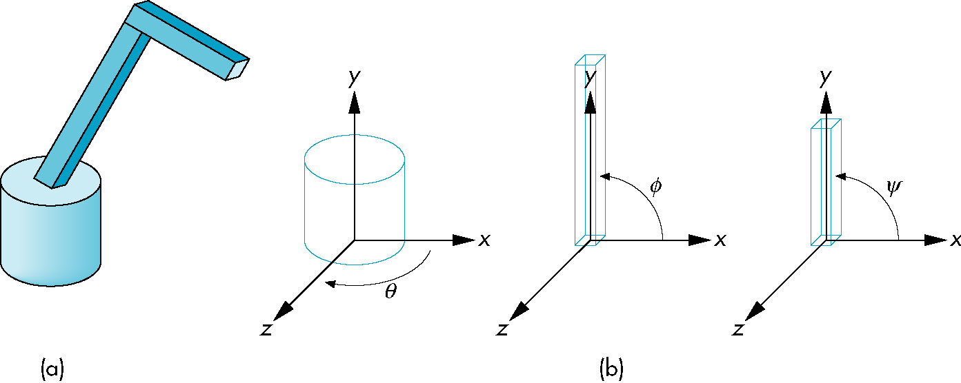
Articulated Models
  <number>/43
robotArm演示
parts in their own coodinate systems
robot arm
Robot arm is an example of an articulated model
  Parts connected at joints
  Can specify state of model by giving all joint angles
Notes:
articulated [ɑː'tɪkjʊleɪtɪd] 详细»
adj. 铰接式的；清晰的；组织缜密的；有关节的
v. 铰接（articulate的过去分词）；明确地表达；使相互连贯

Slide 18
Relationships in Robot Arm and Required Matrices
  <number>/43
Rotation of base: R_{b}
  Apply M = R_{b} to base
Translate lower arm relative to base: T_{lu}
Rotate lower arm around joint: R_{lu}
  Apply M = R_{b} T_{lu} R_{lu} to lower arm
Translate upper arm relative to upper arm: T_{uu}
Rotate upper arm around joint: R_{uu}
  Apply M = R_{b} T_{lu} R_{lu} T_{uu} R_{uu} to upper arm
Notes:
Base rotates independently
Single angle determines position
Lower arm attached to base
Its position depends on rotation of base
Must also translate relative to base and rotate about connecting joint
Upper arm attached to lower arm
Its position depends on both base and lower arm
Must translate relative to lower arm and rotate about joint connecting to lower arm

Slide 19
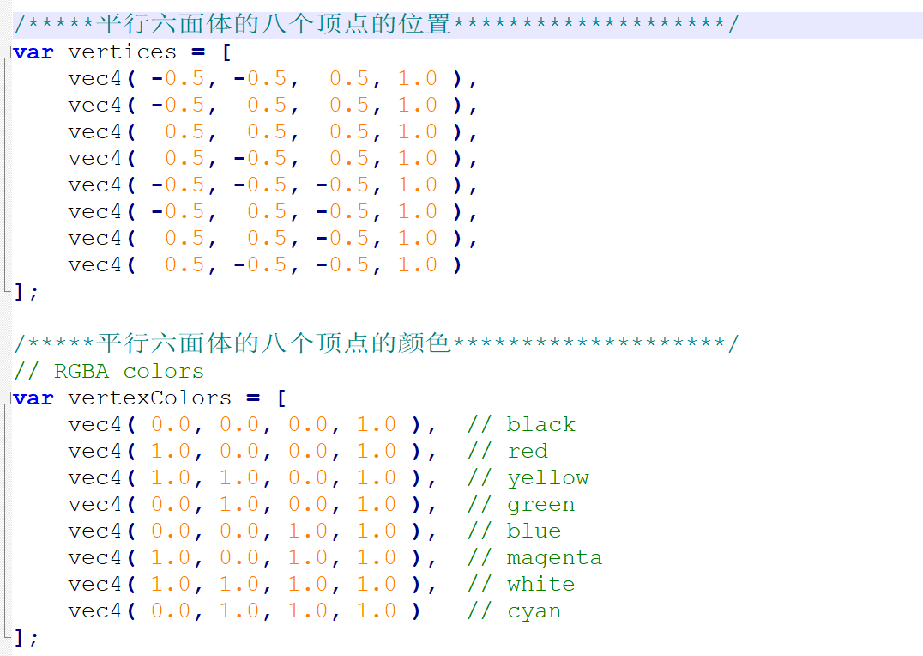
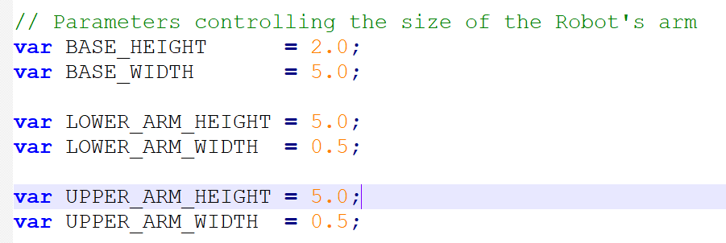
Building the Model
  <number>/43
包含三个实例instance，每个都采用六面体图符symbol

Slide 20
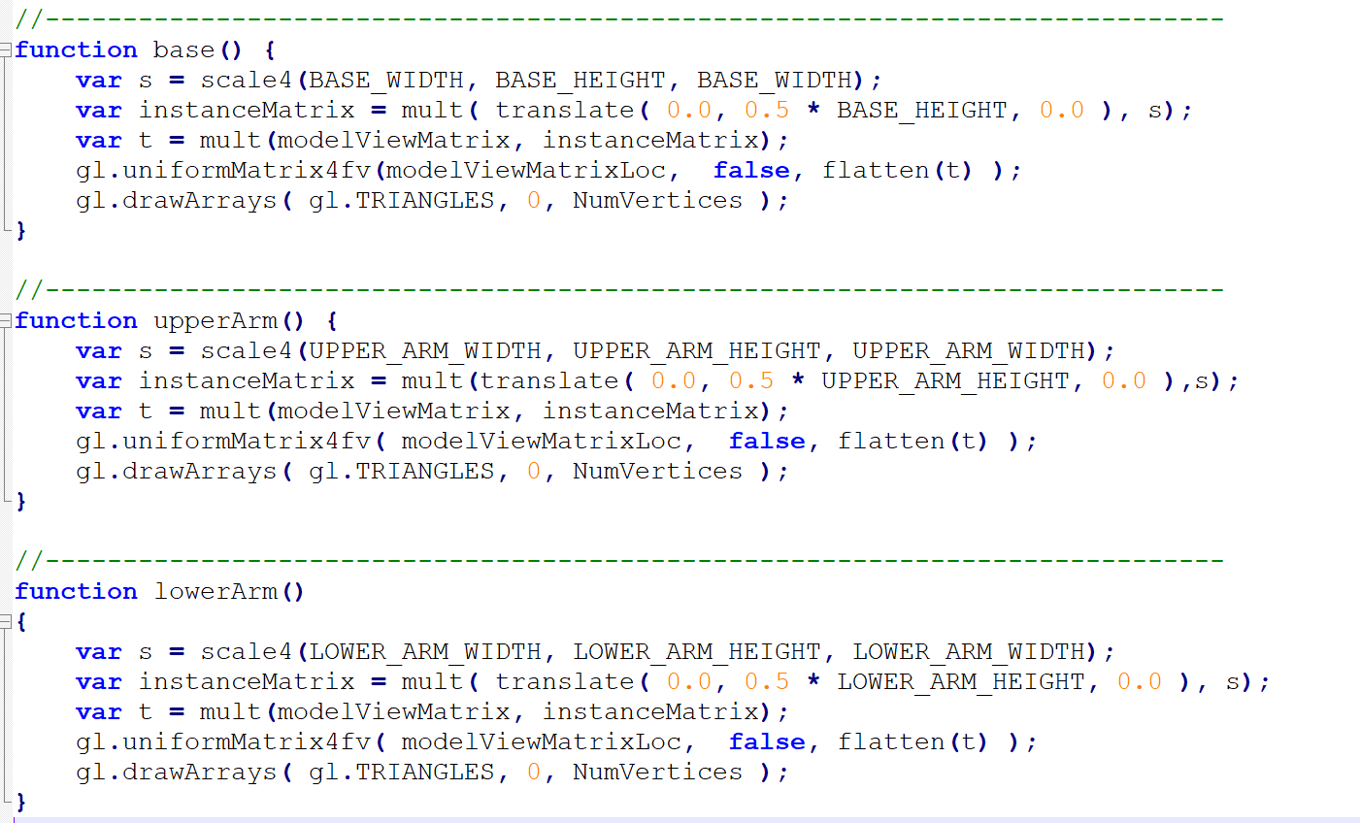
节点的代码
  <number>/43
instanceMatrix： 实例变换矩阵
modelviewMatrix: 当前模视变换矩阵
包含三个实例instance，每个都采用六面体图符symbol
Notes:
function base() {
var s = scale4(BASE_WIDTH, BASE_HEIGHT, BASE_WIDTH);
var instanceMatrix = mult( translate( 0.0, 0.5 * BASE_HEIGHT, 0.0 ), s);
var t = mult(modelViewMatrix, instanceMatrix);
gl.uniformMatrix4fv(modelViewMatrixLoc, false, flatten(t) );
gl.drawArrays( gl.TRIANGLES, 0, NumVertices );
}

Slide 21
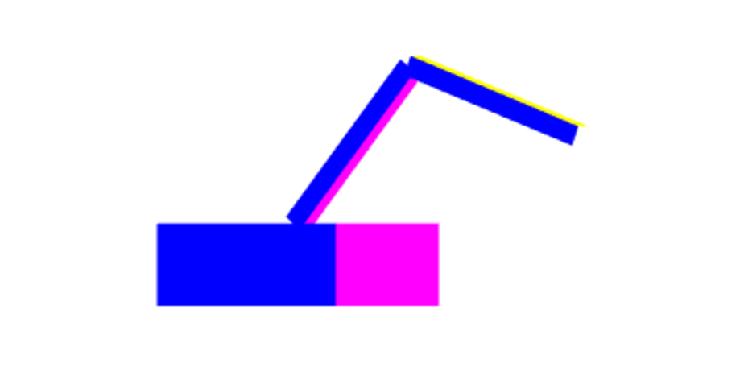
render for RobotArm
  <number>/43
var render = function() {
gl.clear( gl.COLOR_BUFFER_BIT | gl.DEPTH_BUFFER_BIT );
modelViewMatrix = rotate(theta[Base], 0, 1, 0 );
base();
modelViewMatrix = mult(modelViewMatrix, translate(0.0, BASE_HEIGHT, 0.0));
modelViewMatrix = mult(modelViewMatrix, rotate(theta[LowerArm], 0, 0, 1 ));
lowerArm();
modelViewMatrix = mult(modelViewMatrix, translate(0.0, LOWER_ARM_HEIGHT,0.0));
modelViewMatrix = mult(modelViewMatrix,rotate(theta[UpperArm], 0, 0, 1) );
upperArm();
requestAnimFrame(render);
}
三个实例采用增量的模视变换矩阵

Slide 22
Generalizations
  <number>/43
Need to deal with multiple children
  How do we represent a more general tree?
  How do we traverse such a data structure?
Animation
  How to use dynamically?
  Can we create and delete nodes during execution?
Notes:
后面的孩子兄弟模型可以解决上述两个问题

Slide 23
  <number>/43
Outline
Examine the limitations of linear modeling
  Symbols and instances（图符和实例）
Introduce hierarchical models层级模型
  Articulated models（铰接模型）
    Example RobotArm: Simple tree
    Example Figure: Left-Child Right-Sibling Tree
Notes:
模型是对世界的抽象。
计算机科学领域，使用“抽象数据类型”表示对象之间的结构关系；图形学中用“几何对象”构建世界的模型。
需要选择模型使用的图元及图元之间的关系。因为好的模型能够充分利用图形系统的性能。

Slide 24
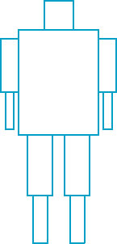
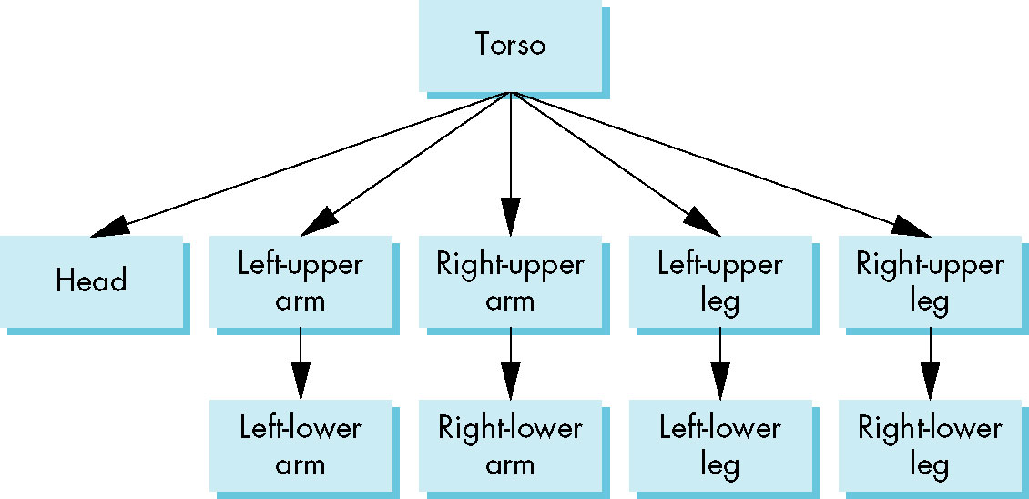
Humanoid Figure-example
  <number>/43
Build a tree-structured model of a humanoid figure(类人机器人)
  Examine various traversal strategies
  Build a generalized tree-model structure that is independent of the particular model

Slide 25
Building the Model
  <number>/43
Can build a simple implementation using quadrics（二次曲面）: ellipsoids（椭圆体） and cylinders（圆柱）
Access parts through functions
  torso()//躯干
  leftUpperArm()//左上臂
Matrices describe position of node with respect to its parent
  M_{lla} positions left lower leg with respect to left upper arm

Slide 26
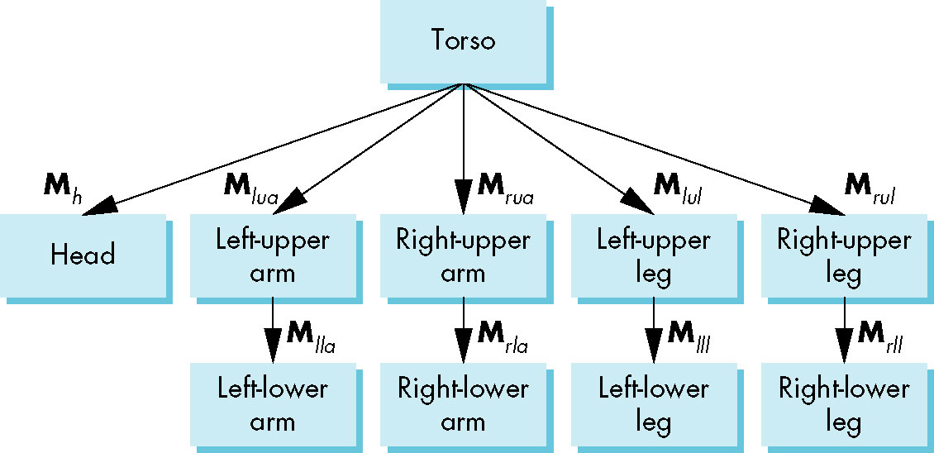
Tree with Matrices
  <number>/43
边上标示了递增变换矩阵的树结构
  如Mlla: left lower arm Matrix

Slide 27
Display and Traversal
  <number>/43
图的位置由11个角度参数确定
  The position of the figure is determined by 11 joint angles (two for the head and one for each other part)
整个树的显示需要图遍历
  Display of the tree requires a graph traversal
    Visit each node once
    Display function at each node that describes the part associated with the node, applying the correct transformation matrix for position and orientation
    遍历树：深度优先或宽度优先搜索算法
Notes:
2+1+4+4=11

Slide 28
Transformation Matrices
  <number>/43
There are 10 relevant matrices
  躯干M
    positions and orients entire figure through the torso which is the root node
  头M_{h}
    positions head with respect to torso
  上臂，上腿M_{lua}, M_{rua}, M_{lul}, M_{rul}
    position arms and legs with respect to torso
  下臂，下腿M_{lla}, M_{rla}, M_{lll}, M_{rll}
    position lower parts of limbs with respect to corresponding upper limbs

Slide 29
Stack-based Traversal
  <number>/43
Set model-view matrix to M and draw torso
Set model-view matrix to MM_{h} and draw head
For left-upper arm need MM_{lua} and so on
Rather than recomputing MM_{lua} from scratch or using an inverse matrix, use the matrix stack to store M and other matrices as we traverse the tree
Notes:
实现遍历树时，采用栈结构存储所需矩阵和属性信息，或者采用递归函数实现树的遍历

Slide 30
Stack-based
Traversal Code
  <number>/43
figure() {
PushMatrix()
torso();
Rotate (…);
head();
PopMatrix();
PushMatrix();
Translate(…);
Rotate(…);
left_upper_arm();
PopMatrix();
PushMatrix();
save present model-view matrix
update model-view matrix for head
recover original model-view matrix
save it again
update model-view matrix
for left upper arm
recover and save original
model-view matrix again
rest of code
Notes:
这里是伪代码，采用栈
没有实现代码？

Slide 31
Analysis（存在的问题）
  <number>/43
The code describes a particular tree and a particular traversal strategy
Can we develop a more general approach? 通用方法
Notes:
另外的问题：
Note that the sample code does not include state changes, such as changes to colors
May also want to push and pop other attributes to protect against unexpected state changes affecting later parts of the code

Slide 32
General Tree Data Structure
  <number>/43
Need a data structure to represent tree and an algorithm to traverse the tree
使用更强大的树层级结构实现方法
use a left-child right sibling structure（左孩子右兄弟）
    Uses linked lists链表
    Each node in data structure is two pointers
      Left: next node
      Right: linked list of children
Notes:
sibling ^{报错} 英 ['sɪblɪŋ] 美 ['sɪblɪŋ] 全球发音 跟读 口语练习
n. 兄弟姊妹；民族成员
（ （建模和绘制没有区分开） ）

Slide 33
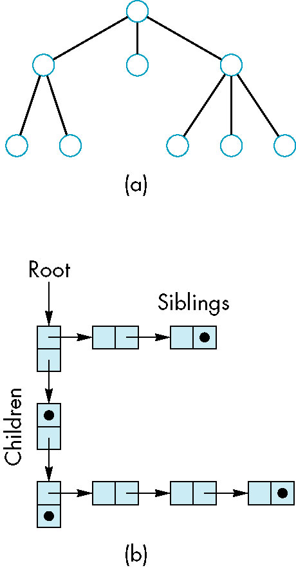
Left-Child Right-Sibling Tree
  <number>/43
左孩子右兄弟结构~表示类人机器人实例

Slide 34
Possible Node Structure
  <number>/43
每个节点包含下面4项目信息
render
Code for drawing part or
pointer to drawing function
transform
matrix relating node to parent
child
sibling
linked list of pointers to children
linked list of pointers to sibling

Slide 35
Tree node Structure
  <number>/43
At each node we need to store
  Pointer to sibling
  Pointer to child
  Pointer to a function that draws the object represented by the node
  Homogeneous coordinate matrix to multiply on the right of the current model-view matrix
    Represents changes going from parent to node
    In WebGL this matrix is a 1D array storing matrix by columns

Slide 36
Creating null treenodes
  <number>/43
Figure演示讲解
var figure = [];
for( var i=0; i<numNodes; i++)
figure[i] = createNode(null, null, null, null);
function createNode (transform, render, sibling, child)
{ var node = {
  transform: transform,
  render: render,
  sibling: sibling,
  child: child, }
return node;
};
Notes:
根据图符个数，创建空的节点结构（figure[i] = createNode(null, null, null, null);
）

Slide 37
节点id（索引）
  <number>/43
var torsoId = 0;
var headId = 1;
var head1Id = 1;
var head2Id = 10;
var leftUpperArmId = 2;
var leftLowerArmId = 3;
var rightUpperArmId = 4;
var rightLowerArmId = 5;
var leftUpperLegId = 6;
var leftLowerLegId = 7;
var rightUpperLegId = 8;
var rightLowerLegId = 9;

Slide 38
Initializing Nodes
  <number>/43
function initNodes(Id) {
var m = mat4();
switch(Id) {
case torsoId:
m = rotate(theta[torsoId], 0, 1, 0 );
figure[torsoId] = createNode( m, torso, null, headId );
break;
case head1Id:
case head2Id:
m = translate(0.0, torsoHeight+0.5*headHeight, 0.0);
m = mult(m, rotate(theta[head1Id], 1, 0, 0))m = mult(m,
rotate(theta[head2Id], 0, 1, 0));
m = mult(m, translate(0.0, -0.5*headHeight, 0.0));
figure[headId] = createNode( m, head, leftUpperArmId, null);
break;
Notes:
根据界面参数，创建或者说修改相应节点的内容（变换矩阵）~与具体模型有关

Slide 39
Notes
  <number>/43
The position of figure is determined by 11 joint angles stored in theta[11]
Animate by changing the angles and redisplaying
We form the required matrices using rotate and translate
Because the matrix is formed using the model-view matrix, we may want to first push original model-view matrix on matrix stack

Slide 40
Preorder Traversal
  <number>/43
function traverse(Id) {
if(Id == null) return;
stack.push(modelViewMatrix);
modelViewMatrix = mult(modelViewMatrix, figure[Id].transform);
figure[Id].render();
//子节点递归绘制，需要弹栈
if(figure[Id].child != null) traverse(figure[Id].child);
modelViewMatrix = stack.pop();
//兄弟节点绘制
if(figure[Id].sibling != null) traverse(figure[Id].sibling);
}
var render = function() {
gl.clear( gl.COLOR_BUFFER_BIT );
traverse(torsoId);
requestAnimFrame(render);
}
Notes:
判定递归结束。
然后三步工作；
绘制该节点
递归孩子
递归兄弟

Slide 41
Notes（注意）
  <number>/43
We must save model-view matrix before multiplying it by node matrix
  Updated matrix applies to children of node but not to siblings which contain their own matrices
The traversal program applies to any left-child right-sibling tree
  The particular tree is encoded in the definition of the individual nodes
The order of traversal matters because of possible state changes in the functions

Slide 42
Dynamic Trees
  <number>/43
因为我们使用JS，所以节点和节点结构可以在执行过程中改变（Because we are using JS, the nodes and the node structure can be changed during execution）
节点和遍历的定义与以前基本相同，但是我们可以在执行过程中添加和删除节点（Definition of nodes and traversal are essentially the same as before but we can add and delete nodes during execution）
在桌面OpenGL中，如果我们使用指针，结构可以是动态的（In desktop OpenGL, if we use pointers, the structure can be dynamic）

